Slide 1
Clock, S-R Flipflop, D Flipflop

Slide 2
External Input to control the circuit
Clock
a periodic external event (input)
Clock
synchronizes when current state changes happen
keeps system well-behaved makes it easier to design and build large systems

Slide 3
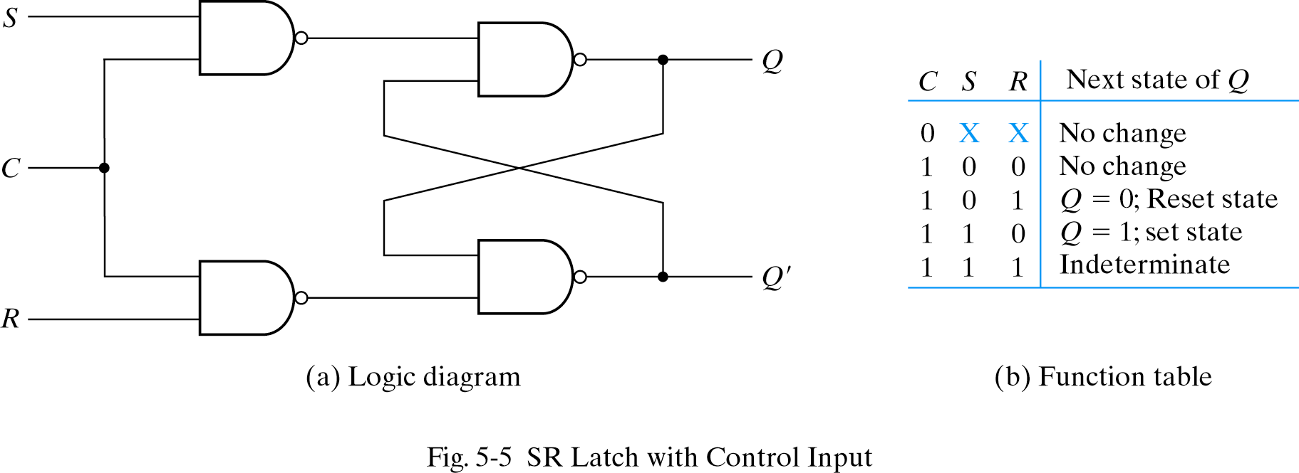
S-R Latch with control input/ S-R flip Flop
Occasionally, desirable to avoid latch changes
C = 0 disables all latch state changes
Control signal enables data change when C = 1
Right side of circuit same as ordinary S-R latch.

Slide 4
D Flip Flop
Q₀ indicates the previous state (the previously stored value)
S
D
Q
C
Q’
R
S R C Q Q’
D C Q Q’
0 0 1 Q₀ Q₀’ Store
0 1 1 0 1 Reset
1 0 1 1 0 Set
1 1 1 1 1 Disallowed
X X 0 Q₀ Q₀’ Store
0 1 0 1
1 1 1 0
X 0 Q₀ Q₀’

Slide 5
D Flip Flop
X
D
S
Q
C
Q’
Y
R
D C Q Q’
0 1 0 1
1 1 1 0
X 0 Q₀ Q₀’
Input value D is passed to output Q when C is high
Input value D is ignored when C is low

Slide 6
D Flip-Flop
Latches on following
edge of clock
C
D
D
Q
D
Q
C
C
Q
Q only changes when C is high
If C is high, Q will follow D
The D latch stores data indefinitely, regardless of input D values, if C = 0
Forms basic storage element in computers

Slide 7
Verilog
module D_FF(D, Clk, Q, Qbar);
input D, Clk;
output Q, Qbar;
always @ (D or Clk) //sensitivity list
if(Clk)
begin
Q <= D;
Qbar <= ~D;
end
endmodule

Slide 8
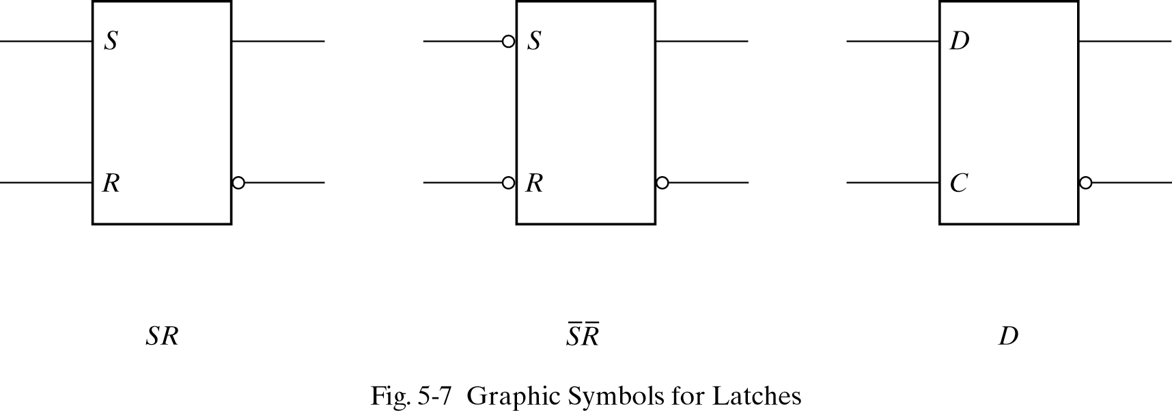
Symbols for Latches
SR latch is based on NOR gates
S’R’ latch based on NAND gates
D latch can be based on either.
D latch sometimes called transparent latch

